Slide 1
Design and Analysis of Algorithms
CSEL30503MJ
Module - 2
Dynamic Programming

Slide 2
Content
Introduction
Matrix Chain Multiplication,
All pair shortest paths,
Single source shortest path,
Longest Common Subsequence,
0/1 Knapsack Problem,
Suggestive Questions

Slide 3
Introduction: Dynamic Programming
Dynamic Programming (DP) is a powerful algorithmic technique used to solve complex problems by breaking them down into simpler subproblems. Its core principle relies on two key properties:
Optimal Substructure: An optimal solution to a problem contains within its optimal solutions to its subproblems.
Overlapping Subproblems: The same subproblems are solved repeatedly during the course of the algorithm.
DP avoids redundant computations by storing the results of subproblems in a table (or array) and looking them up when needed. This approach is more efficient than a naive recursive solution, which would recalculate the same subproblems over and over.

Slide 4
Matrix Chain Multiplication
Problem: Given a sequence of matrices, find the most efficient way to multiply them. The efficiency is determined by the total number of scalar multiplications. Matrix multiplication is associative, meaning the order of operations can be changed without affecting the final product. For example, to multiply matrices A, B, and C, you could do (A × B) × C or A × (B × C).
Explanation: The DP approach for this problem involves finding the optimal parenthesization. A key observation is that the last multiplication splits the chain of matrices into two sub-chains. We can find the optimal solution by trying all possible split points.

Slide 5
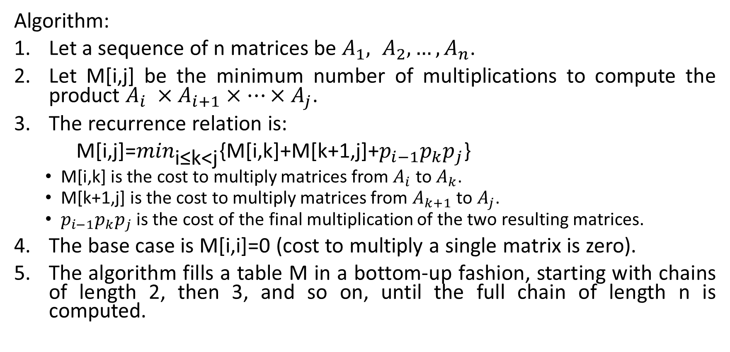
Matrix Chain Multiplication
Algorithm:
Let a sequence of n matrices be $A_{1}, A_{2}, …,A_{n}$.
Let M[i,j] be the minimum number of multiplications to compute the product $A_{i} ×A_{i+1}×⋯×A_{j}$.
The recurrence relation is:
M[i,j]=$\min_{\text{i≤k<j}}${M[i,k]+M[k+1,j]+$p_{i−1}p_{k}p_{j}$}
  M[i,k] is the cost to multiply matrices from $A_{i}$ to $A_{k}$.
  M[k+1,j] is the cost to multiply matrices from $A_{k+1}$ to $A_{j}$.
  $p_{i−1}p_{k}p_{j}$ is the cost of the final multiplication of the two resulting matrices.
The base case is M[i,i]=0 (cost to multiply a single matrix is zero).
The algorithm fills a table M in a bottom-up fashion, starting with chains of length 2, then 3, and so on, until the full chain of length n is computed.

Slide 6
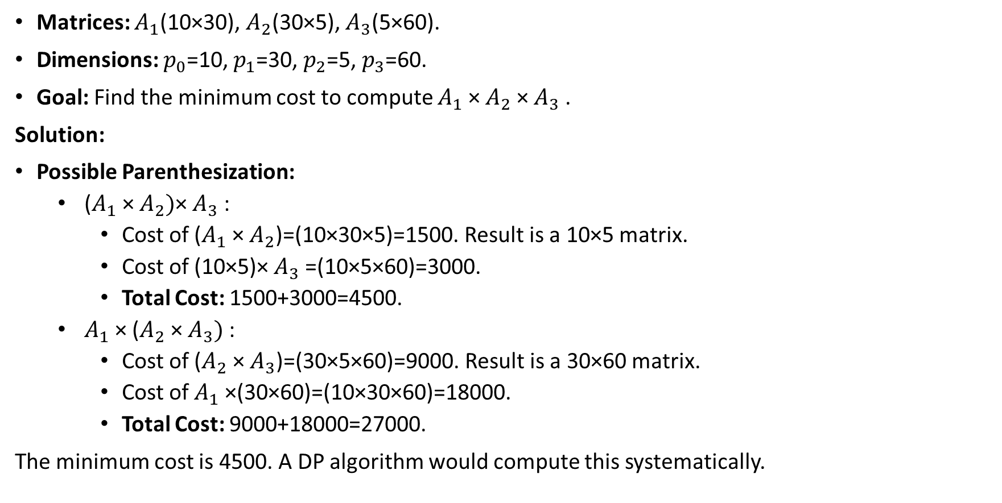
Example: Matrix Chain Multiplication
Matrices: $A_{1}$​(10×30), $A_{2}$​(30×5), $A_{3}$​(5×60).
Dimensions: $p_{0}$​=10,${ p}_{1}$​=30, $p_{2}$​=5, $p_{3}$​=60.
Goal: Find the minimum cost to compute $A_{1}$​× $A_{2}$​× $A_{3}$​.
Solution:
Possible Parenthesization:
  ($A_{1}$​× $A_{2})$​× $A_{3}$​:
    Cost of ($A_{1}$​× $A_{2}$​)=(10×30×5)=1500. Result is a 10×5 matrix.
    Cost of (10×5)× $A_{3}$​=(10×5×60)=3000.
    Total Cost: 1500+3000=4500.
  $A_{1}$​× ($A_{2}$​× $A_{3})$:
    Cost of ($A_{2}$​× $A_{3}$)=(30×5×60)=9000. Result is a 30×60 matrix.
    Cost of $A_{1}$​×(30×60)=(10×30×60)=18000.
    Total Cost: 9000+18000=27000.
The minimum cost is 4500. A DP algorithm would compute this systematically.

Slide 7
All-Pairs Shortest Paths (Floyd-Warshall Algorithm)
Problem: Find the shortest path between all pairs of vertices in a weighted, directed graph. The graph can have negative edge weights, but no negative-weight cycles.
Explanation: The Floyd-Warshall algorithm is a DP solution that iteratively updates the shortest distance between all pairs of vertices. It considers all vertices as potential intermediate vertices in a path.
Algorithm:
Let the graph have n vertices. Initialize a distance matrix D[i,j] with the edge weights. If there is no direct edge from i to j, set D[i,j]=∞.
Iterate through all vertices k from 1 to n.
For each pair of vertices (i,j), update the distance using the formula: D[i,j]=min(D[i,j],D[i,k]+D[k,j])
  This checks if the path from i to j via vertex k is shorter than the currently known shortest path.
After the loops complete, the matrix D will contain the shortest distances between all pairs.

Slide 8
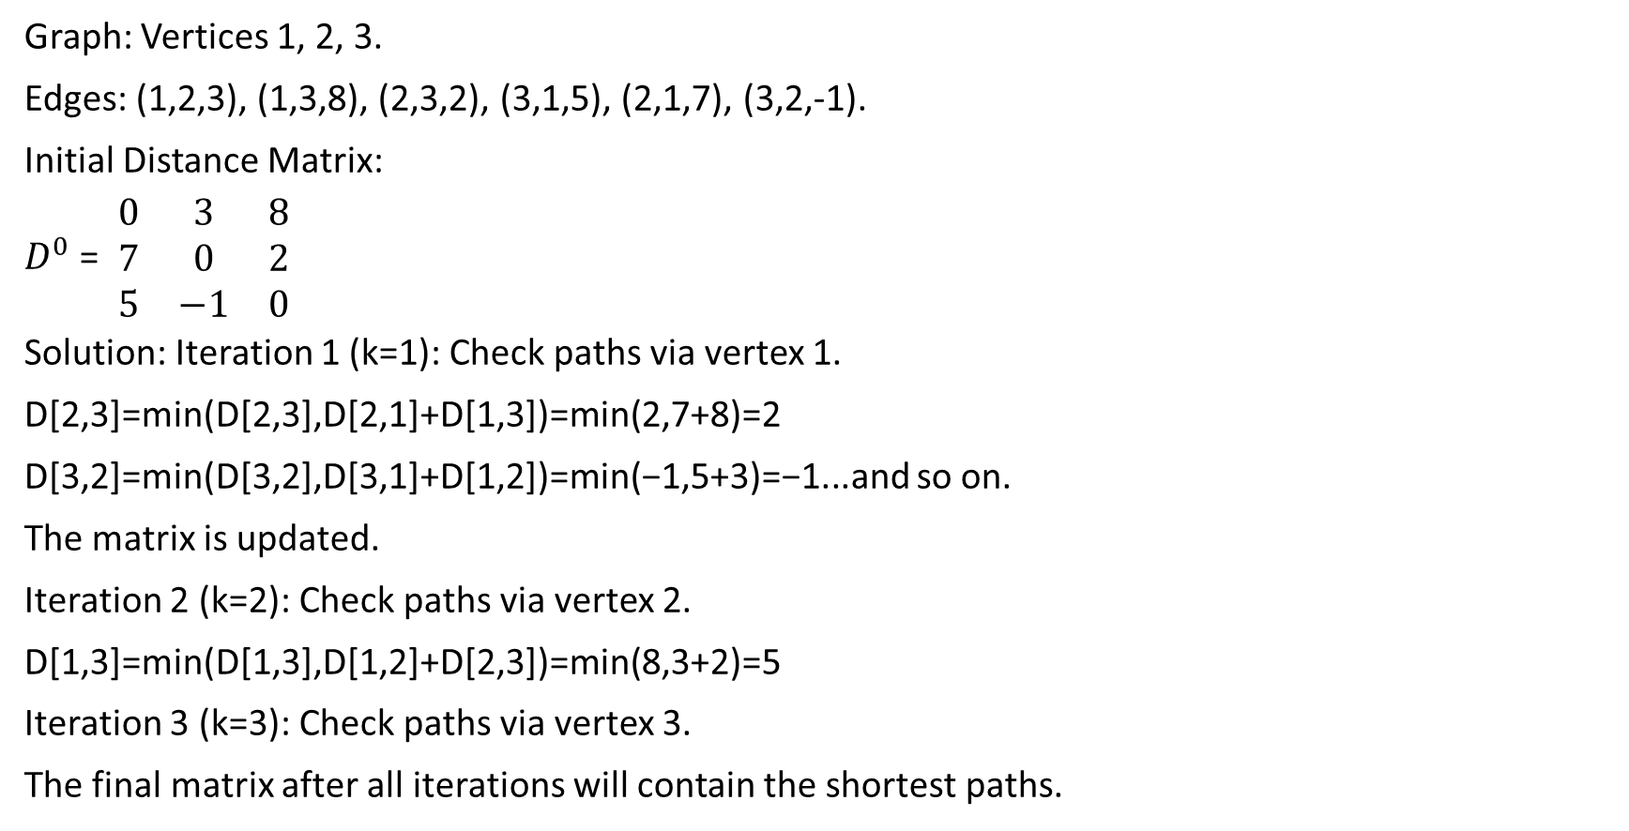
Example: All-Pairs Shortest Paths (Floyd-Warshall Algorithm)
Graph: Vertices 1, 2, 3.
Edges: (1,2,3), (1,3,8), (2,3,2), (3,1,5), (2,1,7), (3,2,-1).
Initial Distance Matrix:
$D^{0}$ = ​ $\begin{matrix}0 & 3 & 8 \\ 7 & 0 & 2 \\ 5 & −1 & 0\end{matrix}$ ​ ​
Solution: Iteration 1 (k=1): Check paths via vertex 1.
D[2,3]=min(D[2,3],D[2,1]+D[1,3])=min(2,7+8)=2
D[3,2]=min(D[3,2],D[3,1]+D[1,2])=min(−1,5+3)=−1...and so on.
The matrix is updated.
Iteration 2 (k=2): Check paths via vertex 2.
D[1,3]=min(D[1,3],D[1,2]+D[2,3])=min(8,3+2)=5
Iteration 3 (k=3): Check paths via vertex 3.
The final matrix after all iterations will contain the shortest paths.

Slide 9
Longest Common Subsequence (LCS)
Problem: Find the longest subsequence that is common to two given sequences. A subsequence is a sequence that can be derived from another sequence by deleting some or no elements without changing the order of the remaining elements.
Explanation: The DP approach for LCS builds a 2D table to store the length of the LCS for all possible prefixes of the two sequences.
Algorithm:
Let the two sequences be X of length m and Y of length n.
Create a table LCS[m+1,n+1].
Iterate through the table, filling it based on the following recurrence relation:
  If X[i−1]==Y[j−1] (the characters match), then LCS[i,j]=1+LCS[i−1,j−1].
  If X[i−1] ≠ Y[j−1] (the characters don't match), then LCS[i,j]=max(LCS[i−1,j],LCS[i,j−1]).
The final value in the bottom-right cell, LCS[m,n], is the length of the LCS. The actual subsequence can be reconstructed by backtracking through the table.

Slide 10
Example: Longest Common Subsequence (LCS)
Sequences: X="AGGTAB", Y="GXTXAYB"
Goal: Find the LCS.
Solution:
We build a table of size (m+1)×(n+1)=7×8.
The final length is found in the last cell, which would be 4.
LCS: "GTAB" (or "GTAYB"). The length is 4.

Slide 11
0/1 Knapsack Problem
Problem: Given a set of items, each with a weight and a value, determine which items to include in a collection so that the total weight is less than or equal to a given capacity and the total value is as large as possible. Each item can either be included entirely (1) or not at all (0).
Explanation: This is a classic DP problem. The solution is built on the decision of whether to include each item or not.
Algorithm:
Let there be n items and a knapsack capacity W.
Create a table K[n+1,W+1]. K[i,w] will store the maximum value achievable with a knapsack of capacity w using items up to i.
The recurrence relation is:
  K[i,w]=K[i−1,w] if the ith item's weight is greater than w.
  K[i,w]=max(K[i−1,w],vi​+K[i−1,w−wi​]) if the ith item's weight is less than or equal to w.
The base cases are K[0,w]=0 and K[i,0]=0.
The final value K[n,W] gives the maximum value.

Slide 12
Example: 0/1 Knapsack Problem
Items:
  Item 1: v=60,w=10
  Item 2: v=100,w=20
  Item 3: v=120,w=30
Knapsack Capacity: W=50
Solution:
We build a table of size 4×51.
The table is filled row by row, considering one item at a time and a capacity from 0 to 50.
For Item 1 (w=10, v=60), for any capacity w≥10, we choose max(K[0,w],60+K[0,w−10]).
The final cell K[3,50] will contain the answer.

Slide 13
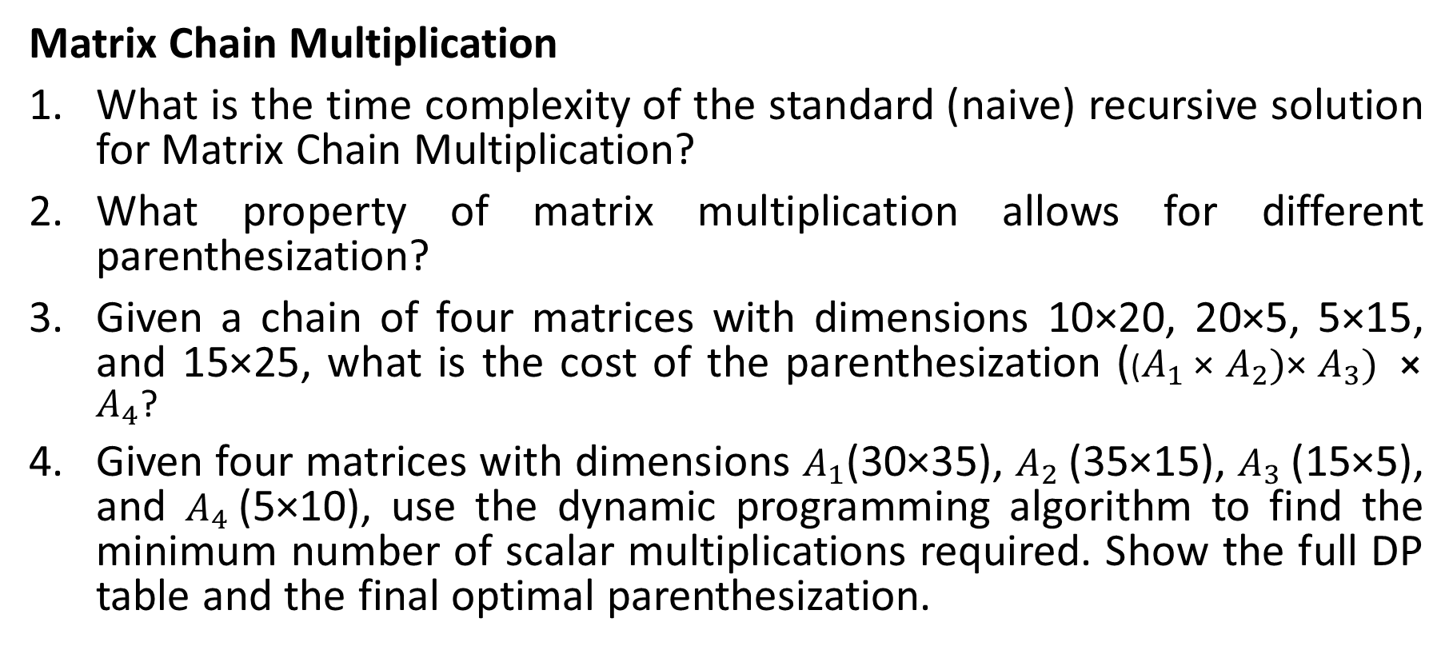
Suggestive Questions
Matrix Chain Multiplication
What is the time complexity of the standard (naive) recursive solution for Matrix Chain Multiplication?
What property of matrix multiplication allows for different parenthesization?
Given a chain of four matrices with dimensions 10×20, 20×5, 5×15, and 15×25, what is the cost of the parenthesization (($A_{1}$​× $A_{2})$​× $A_{3}) ⨯A_{4}$​?
Given four matrices with dimensions $A_{1}$(30×35), $A_{2}$​(35×15), $A_{3}$​(15×5), and $A_{4}$​(5×10), use the dynamic programming algorithm to find the minimum number of scalar multiplications required. Show the full DP table and the final optimal parenthesization.

Slide 14
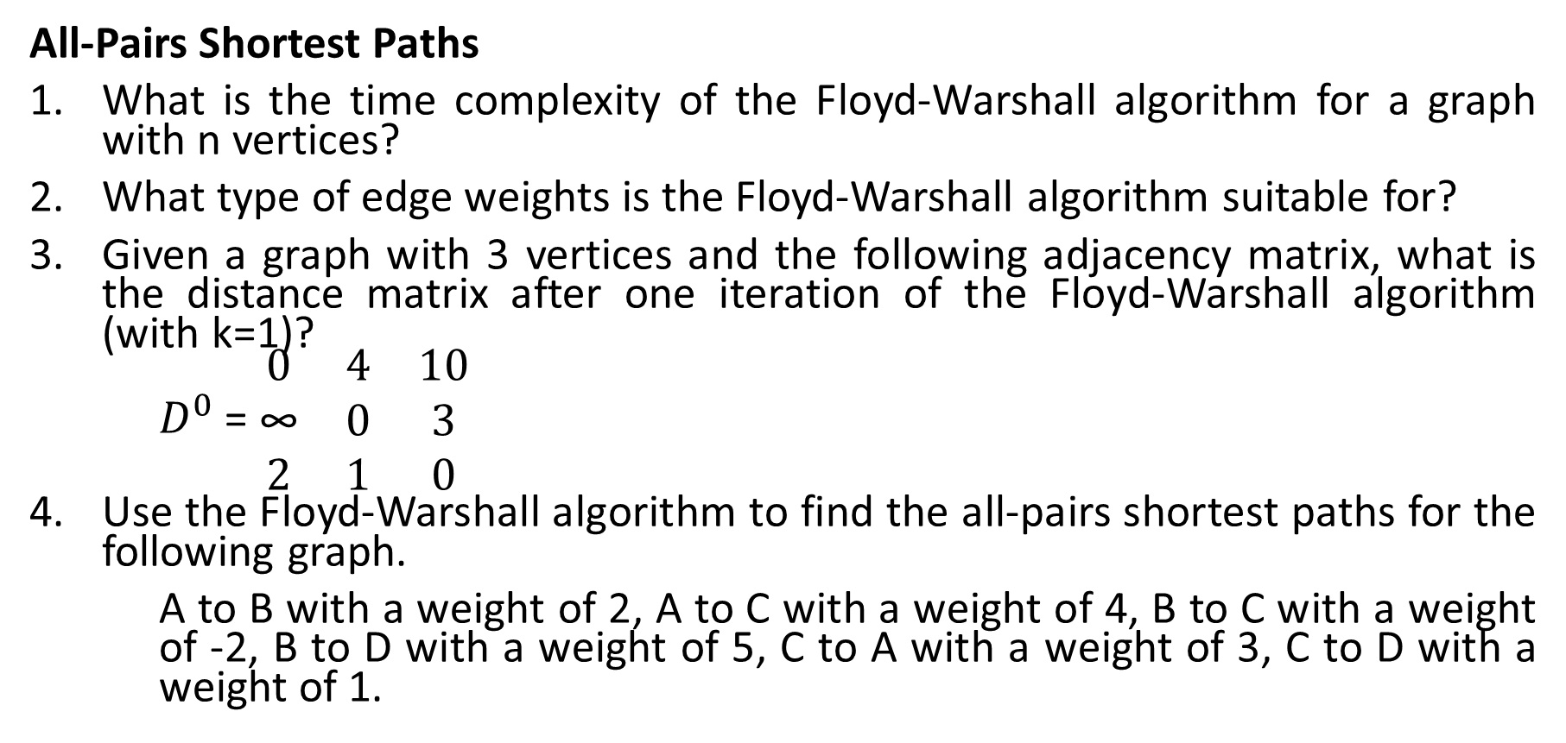
Suggestive Questions
All-Pairs Shortest Paths
What is the time complexity of the Floyd-Warshall algorithm for a graph with n vertices?
What type of edge weights is the Floyd-Warshall algorithm suitable for?
Given a graph with 3 vertices and the following adjacency matrix, what is the distance matrix after one iteration of the Floyd-Warshall algorithm (with k=1)?
$D^{0}$ = ​$\begin{matrix}0 & 4 & 10 \\ \text{∞} & 0 & 3 \\ 2 & 1 & 0\end{matrix}$​ ​
Use the Floyd-Warshall algorithm to find the all-pairs shortest paths for the following graph.
A to B with a weight of 2, A to C with a weight of 4, B to C with a weight of -2, B to D with a weight of 5, C to A with a weight of 3, C to D with a weight of 1.

Slide 15
Suggestive Questions
Longest Common Subsequence (LCS)
What is the time complexity of the DP solution for LCS?
In the LCS recurrence relation, what is the meaning of LCS[i,j]=1+LCS[i−1,j−1]?
Given sequences X="ABCD" and Y="AXBZC", fill in the DP table to find the length of the LCS.
Given sequences X="GAC" and Y="AGCAT", use the DP algorithm to find the length of the LCS and then reconstruct one of the actual common subsequences.

Slide 16
Suggestive Questions
0/1 Knapsack Problem
Why is the 0/1 Knapsack problem not suitable for a greedy approach?
What does the entry K[i,w] in the DP table for the 0/1 Knapsack problem represent?
Given items with values and weights: Item 1 (v=10,w=5), Item 2 (v=20,w=10), Item 3 (v=15,w=8), and a knapsack capacity of 15, what is the maximum value?
Given items with weights and values as follows:
  Item 1: w=10,v=60
  Item 2: w=20,v=100
  Item 3: w=30,v=120 Use the dynamic programming approach to fill out the DP table for a knapsack with a capacity of 50. What is the maximum value, and which items are included?

